Slide 1

MadhuVista : Your Diabetes Ally
Inhouse Project
Semester 8 Final Review
Project Mentor : Prof. Pallavi Saindane
Group Number : 45
Group Members :
Sanjana Asrani 01/D17B
Karina Karira 30/D17A
Simran Lahrani 34/D17A
Roshni Wadhwani 70/D17A

Slide 2
Content
Introduction to Project
Lacuna in the existing systems
Problem Definition
Literature Survey
Methodology employed
Hardware, Software, tools and the constraints
Block Diagram
Modular Diagram
Next Work Plan
Conclusion
References

Slide 3
Introduction to Project
Diabetes Mellitus, a chronic metabolic disorder, is a global health concern affecting millions of individuals worldwide. In India, diabetes has reached alarming proportions, affecting an estimated 77 million people, as reported by the International Diabetes Federation. Both the number of cases and the prevalence of diabetes have been steadily increasing over the past few decades.
Monitoring, whether invasive or non-invasive, is essential for diabetes management as it enables individuals to track their blood glucose levels regularly. This practice allows for timely interventions such as adjusting medication, diet, and lifestyle, thereby preventing dangerous fluctuations and long-term complications associated with diabetes.

Slide 4
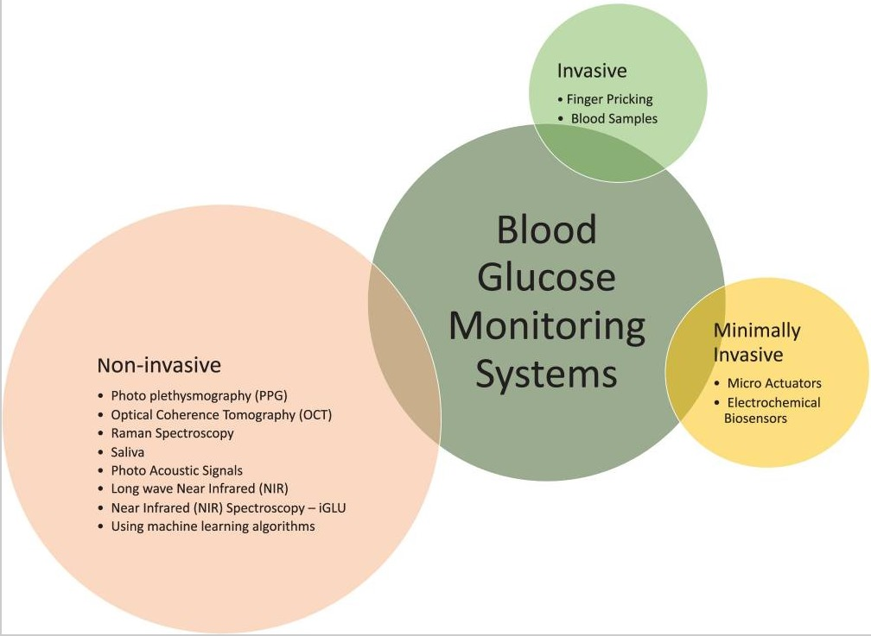
Existing system : Pros and cons

Slide 5
Existing system : Pros and cons
Urine Test Strips:
Urine test strips detect ketones in urine, indicating potential insulin deficiency, but they don't directly measure blood glucose levels. While simple to use, they're less accurate than blood glucose meters and not ideal for routine monitoring.
Laboratory Blood Tests:
Periodic blood tests measure glycated hemoglobin (HbA1c) levels, reflecting average blood glucose levels over 2-3 months. This method offers convenience and a longer-term perspective but lacks immediate adjustments and requires less frequent monitoring compared to daily testing.
Blood Glucose Meters:
Blood glucose meters provide quick and portable glucose level readings through a small blood sample from a fingertip prick. They offer convenience but require regular fingersticks and testing frequency may vary based on treatment plans.

Slide 6
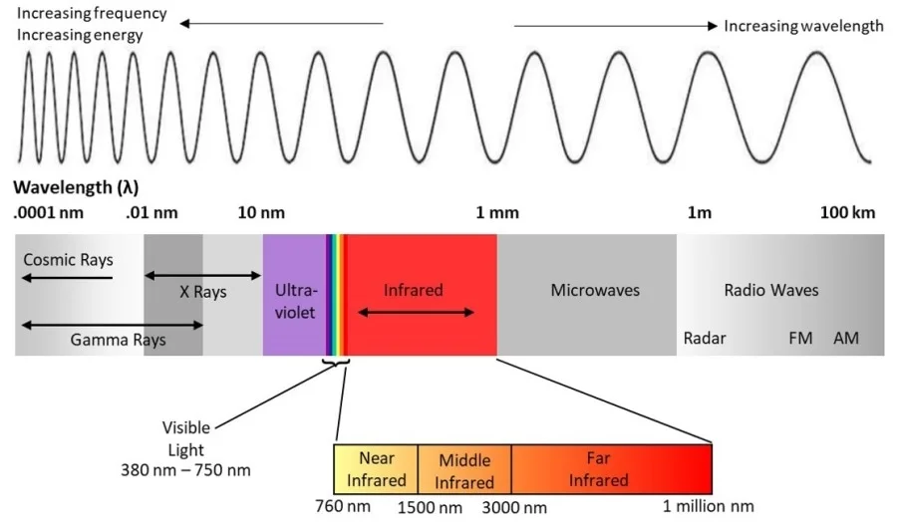
Problem Definition
Aim:
Investigate existing non-invasive blood glucose monitoring technologies.
Lack of calibration stability in non-invasive technology has confined the field to short-term proof of principle. Among non-invasive technologies such as electrical, thermal, chemical, acoustical, and optical methodologies, light offers the least intrusive probing of all technologies investigated.

Slide 7
Can BGL be measured through IR Sensors NI?
According to the Beer-Lambert law of linear regression method, it is assumed that the light attenuation is linearly proportional to the blood glucose concentration and that analyzed samples are non-scattering. However, there is a nonlinear relationship between the glucose absorption spectrum and its concentration.
The principle behind using IR sensors for blood glucose measurement lies in exploiting the absorption properties of glucose in the near-infrared region. Glucose molecules have characteristic absorption peaks in this spectral range, which can be utilized to estimate glucose concentration.
Near-Infrared spectroscopy is an optical method in which scattered, transmitted, or reflected light from the illuminated surface is studied. NIR waves lie in the EM bandwidth of 700–2500 nm. penetration reduces with an increase in wavenumber.

Slide 8
Literature Survey
Sr. no. | Title | Date | Author | Conference | Summary
1 | Non-invasive Blood Glucose Measurement System | 2019 | Deepthi S, Nikita S. Valke, Parvathy J. P. , Anjaly Krishna Sai, Guttappa Sajjan | IEEE International WIE Conference on Electrical and Computer Engineering (WIECON-ECE) | A non-invasive blood glucose measurement system is proposed, using near-infrared sensors (940nm wavelength) to detect glucose concentration. It calculates glucose levels by measuring voltage variations through the finger with an Arduino UNO-based algorithm, achieving 97.5% accuracy.
2 | Optical Based Non Invasive Glucometer with IoT | 2018 | Saina Sunny, S.Swapna Kuma | International Conference on Power, Signals, Control and Computation (EPSCICON) | The paper proposes a non-invasive method for monitoring glucose levels in diabetes using optical and IoT technologies. It employs IR LEDs (wavelength: 650-2500nm) and NIR photodiodes, applying the Beer-Lambert law for signal processing. Real-time data transmission is enabled through GSM-based IoT, implemented via Arduino IDE to enhance performance and enable analytical studies.

Slide 9
Literature Survey
3 | Noninvasive Blood Glucose Monitoring Systems Using Near-Infrared Technology—A Review | 2022 | Aminah Hina, Wala Saadeh | Ahmed Toaha Mobashsher, Academic Editor | This review paper briefly discusses the noninvasive glucose measuring technologies and their related research work. The technologies discussed are optical, transdermal, and enzymatic. The paper focuses on Near Infrared (NIR) technology and NIR Photoplethysmography (PPG) for blood glucose prediction. Feature extraction from PPG signals and glucose prediction with machine learning methods are discussed.
4 | Noninvasive Optical Diagnostic Techniques for Mobile Blood Glucose and Bilirubin Monitoring | 2018 | Bahareh Javid, Faranak Fotouhi-Ghazvini, and Fahime Sadat Zakeri; | J Med Signals Sens | This paper proposes that it is possible to use noninvasive methods to predict the glucose or bilirubin concentration.It proves that the output voltage of the sensor increases in transmittance mode and decreases in reflectance mode.In vivo experiments for glucose were carried out with 19 persons in training phase, and five persons were used for testing the model.

Slide 10
Literature Survey
5 | Comparative Analysis of Regressor Models on Non-invasive Blood Glucose Dataset | 2022 | Neha Tuniya, Mahesh Parihar, Shital Patil, Komal Lawand & Hemalata Nawale | Part of the Lecture Notes in Networks and Systems book series (LNNS,volume 394) | In this paper, a near-infrared optical sensor-based non-invasive system has been designed and calibrated against conventional invasive glucose measuring techniques.This paper emphasizes on different approaches using basic regression methods and classical machine learning algorithms like support vector machines, K-nearest neighbor, random forest with their hybrid regression methods for the predictions of blood glucose
6. | Machine learning models for non-invasive glucose measurement: towards diabetes management in smart healthcare | 2022 | Harshita Agrawal, Prateek Jain, Amit M Joshi | Health Technol (Berl) | In this paper various machine learning algorithms including Logistic Regression, KNN, Gaussian Naive Bayes, Linear Regression, Multi-polynomial Regression, Neural Network, XGBoost, Decision Tree, Random Forest and Support Vector Machine are applied on two dataset which are PIDD (UCI repository) and iGLU dataset (iGLU device). Accuracy, Mean Absolute Error (MAE) and Root Mean Square Error (RMSE) are used for comparison purpose.

Slide 11
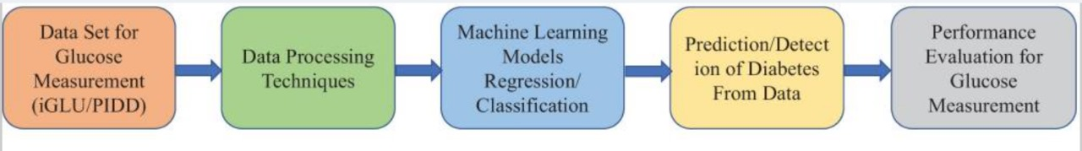
Methodology Employed

Slide 12
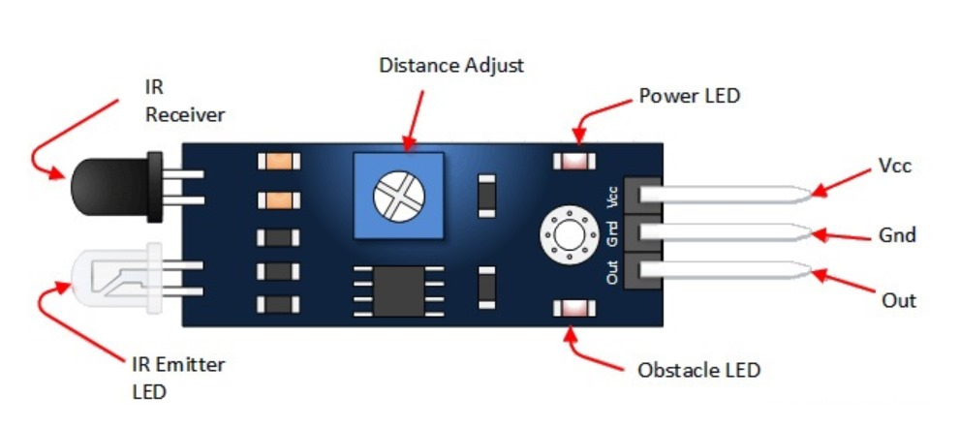
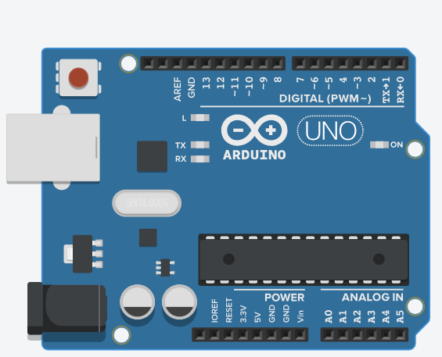
Hardware, Software, Tools and constraint
Languages: Arduino Sketch. (based on C/C++)
IDE: Arduino IDE
Components: IR Sensor: Arduino Uno:

Slide 13
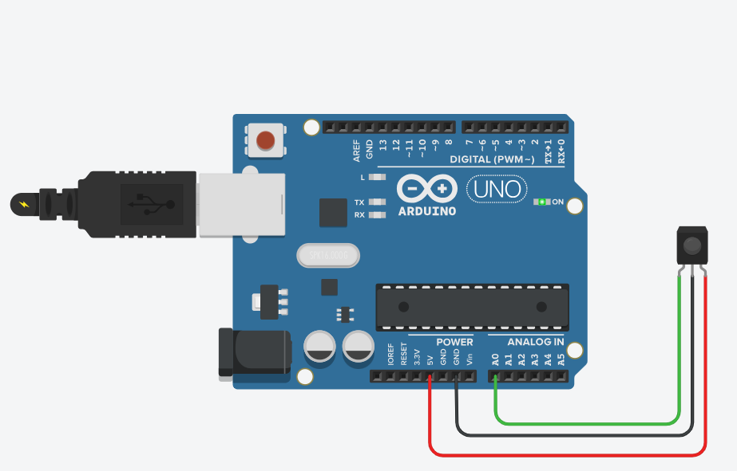
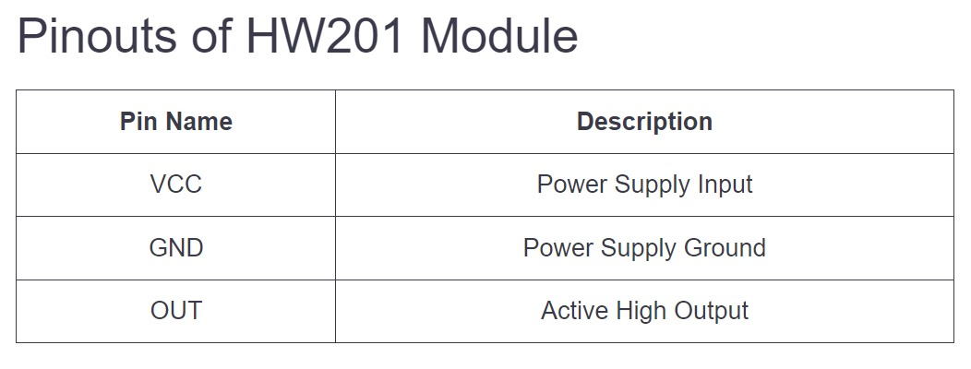
Circuit: HW201 IR sensor, Arduino Uno
The HW201 comprises emitting ( IR LED) and receiving or detector (IR photodiode). The module also has a potentiometer through which one can adjust the detection distance. TR Transmitter in the module emits Radiation. And, if the radiation gets reflected, the IR Receiver detects radiation and its resistance drops down, output goes low.
Active low: Outputs a low signal when it detects infrared radiation i.e. an obstacle.

Slide 14
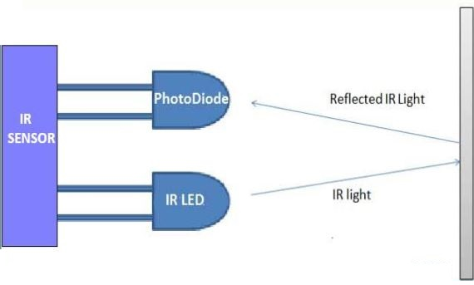
Working of sensor:
When an IR signal is detected, the IR receiver LED will emit a small amount of visible light, which can be used to confirm that a signal has been received.
An IR transmitter LED, on the other hand, is a device that emits infrared light in order to send signals to other devices. It is typically a small, clear, or translucent device that emits IR light in a specific frequency range.

Slide 15
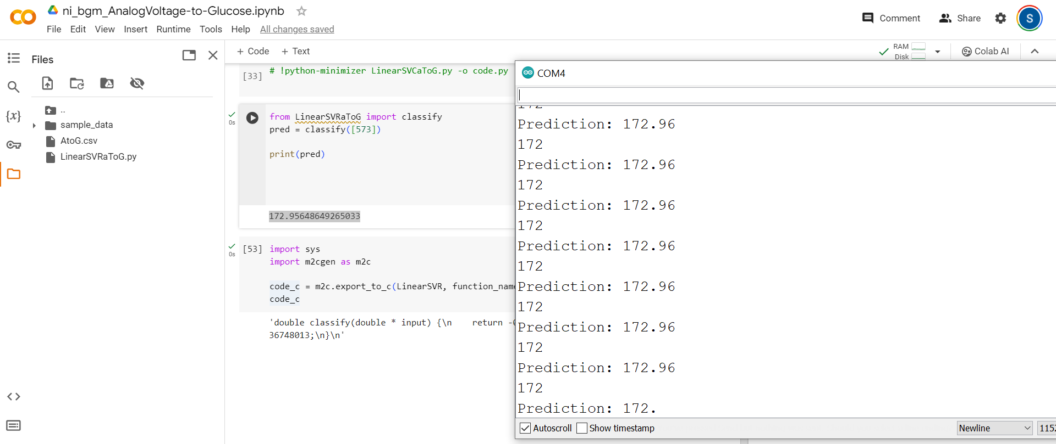
Implementation

Slide 16
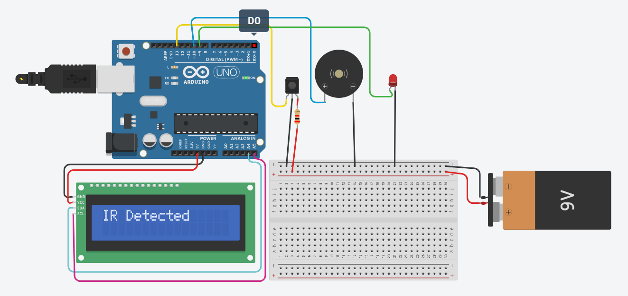
Circuit Diagram:
Simulation consisting of a buzzer, an LED, and LCD with an external 9V battery

Slide 17
Next Work Plan
Increasing accuracy of the model by collecting more data points.
Building a PCB for the implemented circuit.
Integrating LCD (Simulation done) and Bluetooth module HC-05 in our existing circuit.

Slide 18
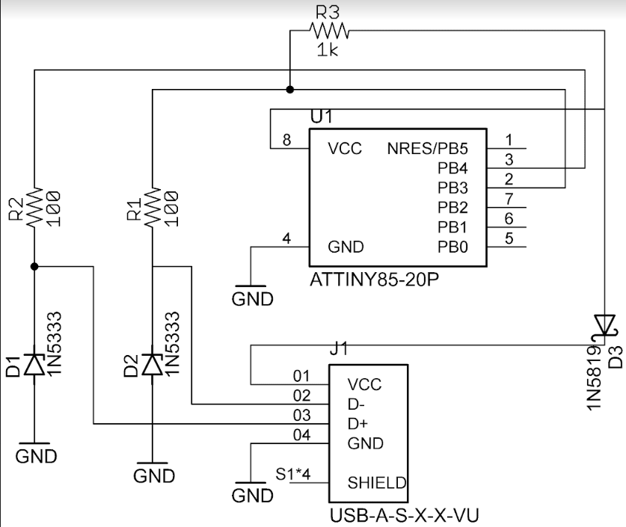
Review 2
We simplified the circuit by replacing the Arduino with an Attiny85 for analog voltage output and mapping it to glucose levels. Initially, we programmed the Attiny85 chip using Arduino and then utilized it as the primary microcontroller. To streamline the process of uploading new programs to the chip, we developed a dedicated PCB instead of relying on Arduino for the upload.
PCB Schematic:

Slide 19
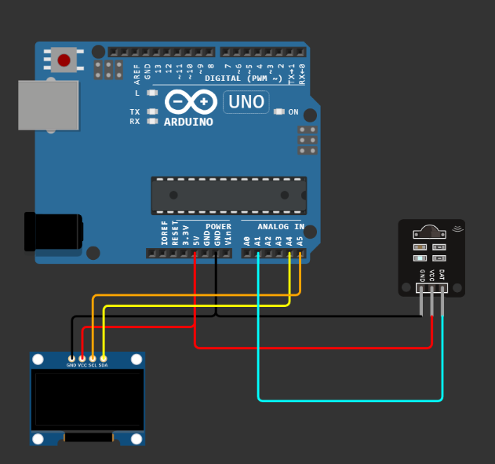
Interfacing OLED with Arduino and IR sensor

Slide 20
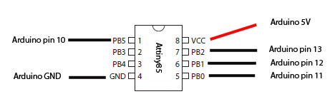
Programming the ATtiny85
Connections:
Process:
After burning the bootloader on ATtiny85, codes that run on Arduino can be run on attiny. This simplifies the circuit but still needs an arduino as an ISP to program it for its use.

Slide 21
Hardware, Software, Tools and constraint
Languages: Arduino Sketch. (based on C/C++), Python for model making.
IDE: Arduino IDE
Components: \ 1. IR Sensor
2. Attiny85/Arduino
3. OLED display

Slide 22
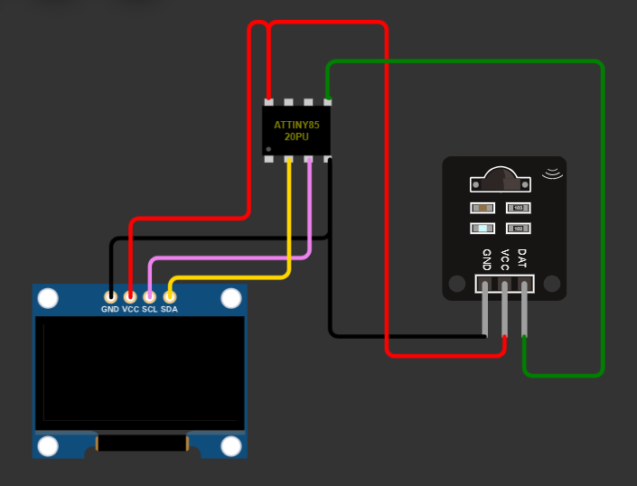
Interfacing of Attiny85 with Oled & IR Sensor
After the Attiny85 has been programmed Using Arduino as ISP or directly (The PCB for the same will be printed soon), Shown connections help do the same task as done using the arduino.
We have used Decision Tree Regressor for the model, and used it in our microcontroller using TinyML (Helps Convert the python model code to any language, here C.)

Slide 23
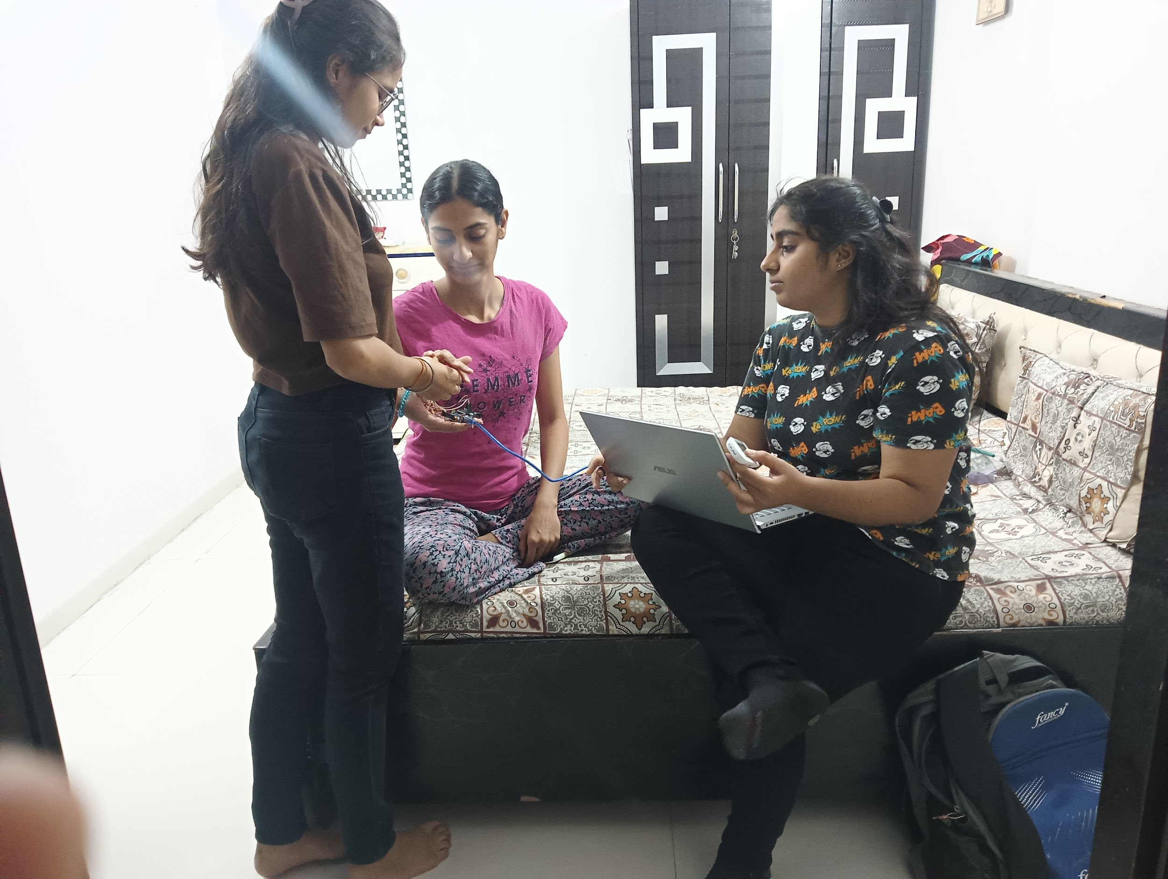
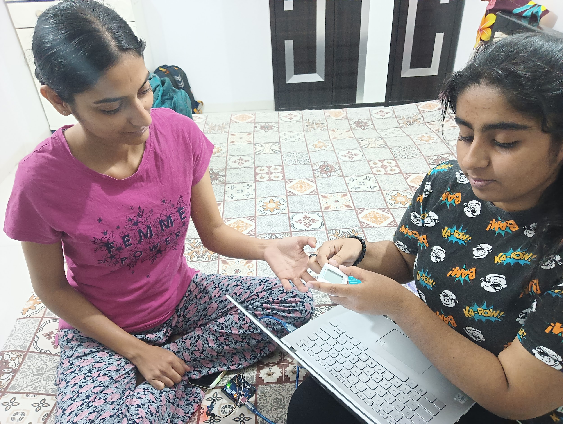
Collecting real data
A model on this data was created, which was then coded into arduino and then attiny85 for testing using TinyML.

Slide 24
Comparison of algorithms implemented on data collected from research papers-I
 | Decision Tree | Random Forest | Linear Regression
Mean Absolute Error | 11.78 | 7.19 | 7.62
Mean Squared Error | 333.76 | 141.71 | 79.93
Root Mean Squared Error | 18.26 | 11.9 | 8.94

Slide 25
Comparison of algorithms implemented on data collected from research papers-II
 | Decision Tree | Random Forest | Linear Regression
Mean Absolute Error | 14.8 | 12.31 | 8.57
Mean Squared Error | 353.2 | 225.06 | 107.05
Root Mean Squared Error | 18.79 | 15 | 10.35

Slide 26
Comparison of algorithms implemented on real data
(The Real data was collected using Accu-check Glucometer and the sensor readings).
 | Decision Tree | Random Forest | Linear Regression
Mean Absolute Error | 3.00 | 7.72 | 12.89
Mean Squared Error | 36.00 | 74.64 | 187.71
Root Mean Squared Error | 6.00 | 8.64 | 13.70

Slide 27
Future Work
Multi Sensor integration like MAX30100, Pulse Sensor, etc. and Collection of data for the same.
Increasing real time data samples for training and testing.
Test PCB made for direct programming of Attiny85 without using an external ISP like Arduino.
Work on Accuracy improvement and reducing overfitting by increasing size of real time dataset.

Slide 28
Issues Faced with the limited real time data:
Overfitting: With limited data, machine learning models may learn to fit the noise in the training data rather than capturing the underlying relationship between sensor readings and glucose levels. This can lead to overfitting, where the model performs well on the training data but fails to generalize to new, unseen data.
Generalization: Limited data may hinder the model's ability to generalize to a wider range of scenarios or conditions. As a result, the model may struggle to accurately predict glucose levels in real-world situations outside the training data distribution.
Bias and Variance: Low data can also lead to biases in the model's predictions, as it may not capture the full complexity of the underlying relationship. Additionally, the model's performance may exhibit high variance, meaning it produces highly variable predictions for similar inputs.

Slide 29
Potential causes of fluctuating IR Sensor Readings:
Environmental Factors: Changes in ambient light, temperature, or humidity can affect the performance of IR sensors. Make sure your setup is in a stable environment to minimize these influences.
Sensor Calibration: IR sensors often require careful calibration to ensure accurate readings. If the sensor is not calibrated correctly, it may produce inconsistent or erroneous results. Make sure to follow the calibration procedures provided by the sensor manufacturer.
Sensor Placement: The placement of the sensor relative to the target (in this case, the finger) is crucial. Even small changes in placement can affect the readings. Ensure that the sensor is positioned consistently and at the optimal distance from the target. (35-degree Detection Angle)
Signal Interference: Other sources of infrared radiation in the environment can interfere with the sensor readings. Try to minimize sources of interference, such as other electronic devices emitting infrared light.
Noise and Variability: IR sensors can be sensitive to noise and variations in the signal. This variability can lead to inconsistent readings, especially in non-invasive applications where the signal may be weaker or more susceptible to interference.

Slide 30
Point to note
Another challenge impacting the accuracy of our readings is the reliance on a univariate model, where only the voltage (x) is considered as a predictor for glucose levels (y). To enhance the accuracy and reliability of our predictions, we plan to expand our model to include additional variables such as age, gender, weight, exercise habits, sleep patterns, and blood pressure alongside voltage. By incorporating these factors into our prediction framework, we aim to create a more comprehensive and robust model that better captures the complexities of blood glucose dynamics.
Despite integrating multiple variables, our model, derived from data collected from five individuals, encountered overfitting issues and exhibited decreased accuracy in predicting blood glucose levels.

Slide 31
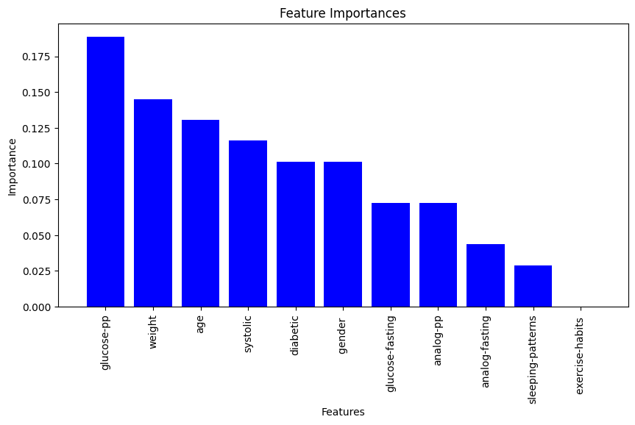
Training Random Forest Classifier for aforementioned parameters:

Slide 32
Conclusion
Hence, two critical conclusions emerge:
1. Addressing accuracy and overfitting necessitates acquiring more data.
2. Employing multiple sensors and refining their calibration processes are pivotal for enhanced performance.

Slide 33
References
S. Deepthi; Nikita S. Valke; J.P. Parvathy; Anjaly Krishna Sai; Guttappa Sajjan, “Non-invasive Blood Glucose Measurement System ”, 2019 IEEE International WIE Conference on Electrical and Computer Engineering (WIECON-ECE), November 2019.
Available: https://ieeexplore.ieee.org/document/9019919
Saina Sunny; S. Swapna Kumar; “Optical based non invasive glucometer with IoT ”; 2018 International Conference on Power, Signals, Control and Computation (EPSCICON), January 2018.
Available: https://ieeexplore.ieee.org/document/8379597
Aminah Hina, Wala Saadeh, “Noninvasive Blood Glucose Monitoring Systems Using Near-Infrared Technology—A Review”, Ahmed Toaha Mobashsher, Academic Editor, June 2022.
Available:https://www.ncbi.nlm.nih.gov/pmc/articles/PMC9268854/

Slide 34
References
4) Bahareh Javid, Faranak Fotouhi-Ghazvini, and Fahime Sadat Zakeri; “Noninvasive Optical Diagnostic Techniques for Mobile Blood Glucose and Bilirubin Monitoring”, J Med Signals Sens, July-September 2018.
Available: https://www.ncbi.nlm.nih.gov/pmc/articles/PMC6116315/
5) Neha Tuniya, Mahesh Parihar, Shital Patil, Komal Lawand & Hemalata Nawale , “Comparative Analysis of Regressor Models on Non-invasive Blood Glucose Dataset”, Part of the Lecture Notes in Networks and Systems book series (LNNS,volume 394), July 2022.
Available: https://link.springer.com/chapter/10.1007/978-981-19-0604-6_19
6) Harshita Agrawal, Prateek Jain, Amit M Joshi , “Machine learning models for non-invasive glucose measurement: towards diabetes management in smart healthcare ”, Health Technol (Berl), August 2022.
Available: https://www.ncbi.nlm.nih.gov/pmc/articles/PMC9386205/

